Slide 1
Design Patterns
Prof. Dr. Dirk Riehle
Friedrich-Alexander University Erlangen-Nürnberg
ADAP C08
Licensed under CC BY 4.0 International
Notes:
It is Friedrich-Alexander University Erlangen-Nürnberg – FAU, in short.
Corporate identity wants us to say “Friedrich-Alexander University”.

Slide 2
Three Examples
File / Directory
Position / Portfolio
TestCase / TestSuite

Slide 3
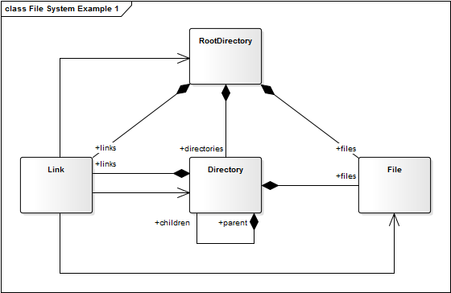
File / Directory Example 1 / 3

Slide 4
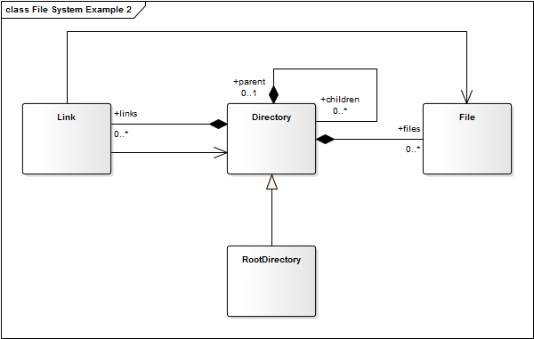
File / Directory Example 2 / 3

Slide 5
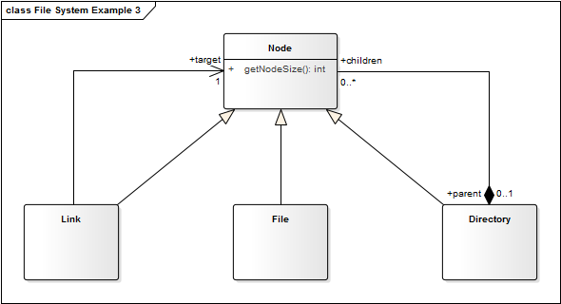
File / Directory Example 3 / 3

Slide 6
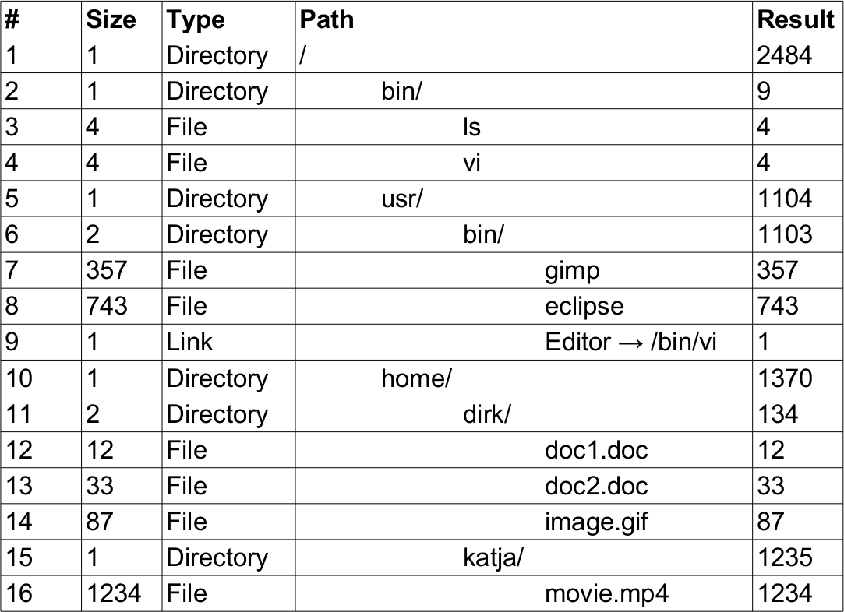
File / Directory Exercise

Slide 7
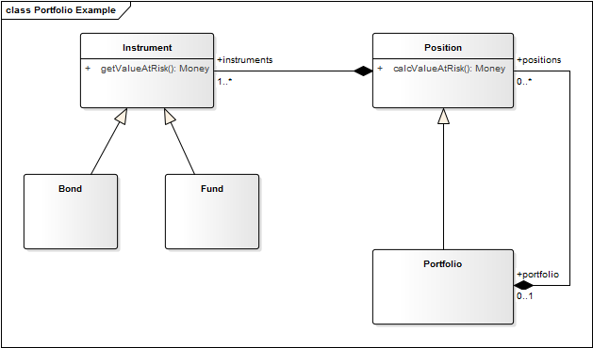
Position / Portfolio Example

Slide 8
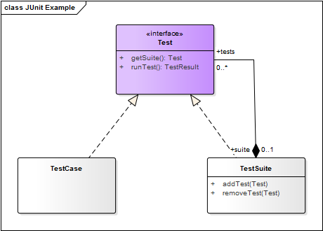
TestCase / TestSuite Example

Slide 9

Composite Structure Diagram (Original)

Slide 10
Quiz: Configuring a Computer
You are configuring a computer. The computer consists of parts. Some parts are atomic (a keyboard, a memory bank, a hard disk), some are composite (memory subsystem, storage subsystem, video subsystem), meaning you can configure its parts.
Using the Composite design pattern, how would you design a class hierarchy to represent a computer configuration?
Select all correct statements.
  Each type of atomic part is represented as its own class.
  Each type of composite part is represented as its own class.
  All part classes are direct subclasses of an abstract Part class.

Slide 11
Answer 1 / 2: Configuring a Computer

Slide 12
Answer 2 / 2: Configuring a Computer
How would you design a class hierarchy to represent a computer configuration?
  Each type of atomic part is represented as its own class.
    Yes. Different types of objects should be represented as different classes.
  Each type of composite part is represented as its own class.
    Yes. Different types of objects should be represented as different classes.
  All part classes are direct subclasses of an abstract Part class.
    No. Having a Part class makes sense, but there will be many part classes that will not be direct subclasses. An example are the classes for the specific types of subsystems.

Slide 13
Definition of Design Pattern
The abstraction of a common solution to a recurring problem for a given context. [DR]

Slide 14
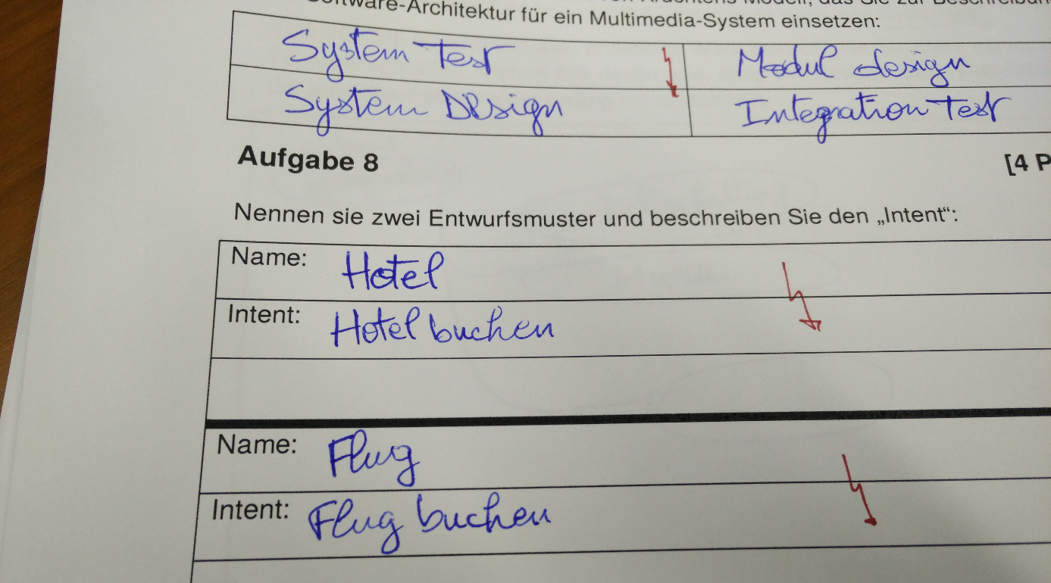
From a Written Exam

Slide 15
Benefits of Using Design Patterns
Faster, better, cheaper …
designing of software
documenting software
communicating designs

Slide 16

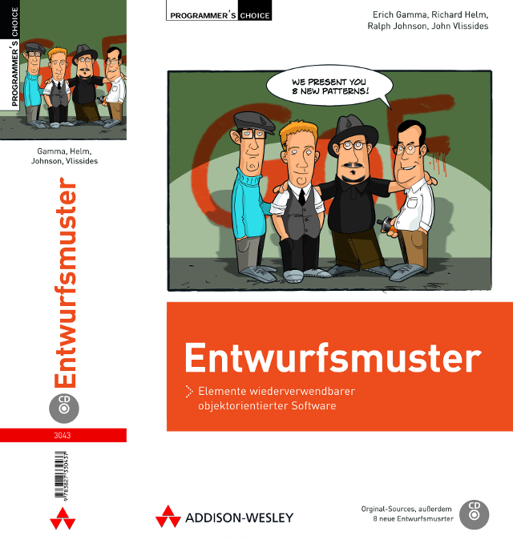
The Design Patterns (“Gang-of-Four”) Book

Slide 17
Highly Abridged History of Design Patterns
A Pattern Language
“No Object is an Island”
ET++ and Interviews
Design Pattern Catalog
A System of Pattern

Slide 18
Pragmatics of Design Patterns
Descriptions
Collections
Applications

Slide 19
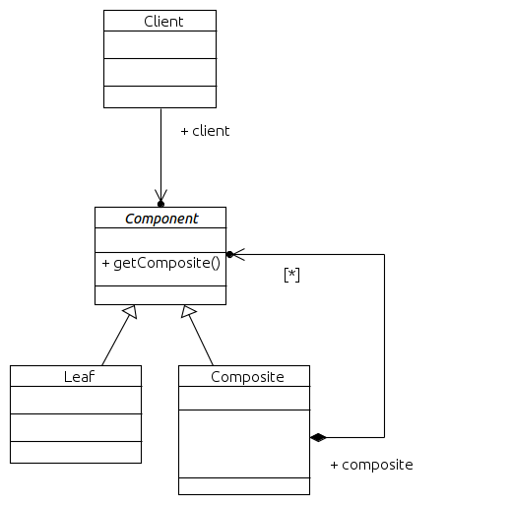
Describing Design Patterns 1 / 2
Problem: How to design a uniform yet flexible object hierarchy?
Context: You need an object hierarchy that you want to handle in a uniform way yet extend it dynamically. Frequently, algorithms need to run over the hierarchy.
Solution: Separate container functionality from domain behavior. Create a container class that can manage, at runtime, components of a generic type. Create all domain-specific classes separately. Make all classes implement the generic component protocol.

Slide 20
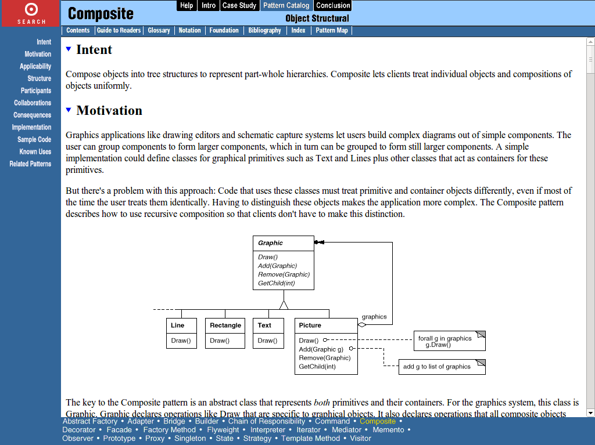
Design Pattern Description Formats 2 / 2

Slide 21
Collections of Design Patterns
Pattern Collections
Pattern Handbooks
Pattern Languages

Slide 22
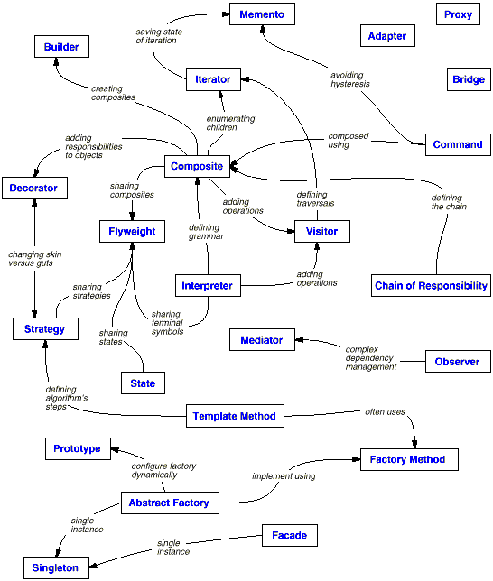
Design Pattern Map

Slide 23
Applying Design Patterns
By-hand Instantiation
As a Design Template
As a Language Feature

Slide 24
Design Pattern vs. Instance (Model)
Pattern
  Illustration, not a model
  Generic terms, for example
    Component, Composite, Leaf
    getComponent, addComponent
Instance
  A specific model (UML, code)
  Specific terms, for example
    Test, TestCase, TestSuite
    run, addTest, getTests

Slide 25
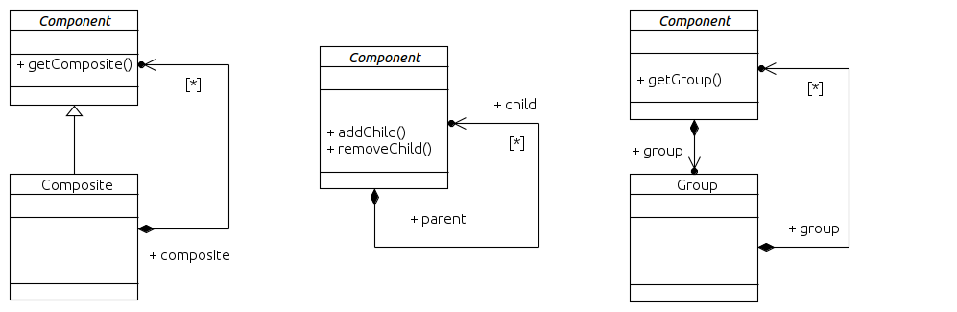
Design Pattern vs. Template

Slide 26
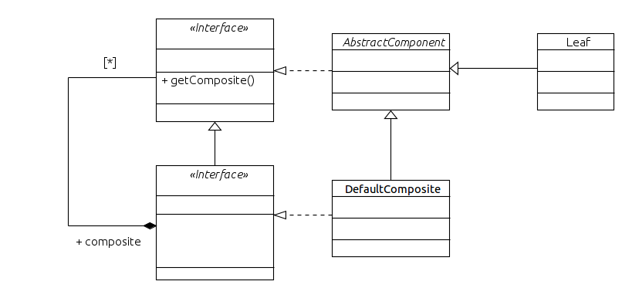
Design vs. Implementation

Slide 27
Quiz: Abstraction Levels
You are looking at a class diagram with class names like KeyboardPart, MemorySubsystem, and GraphicsCard.
The class diagram represents most likely what type of model?
Select all that apply.
  A design pattern
  A design template
  An implementation

Slide 28
Answer: Abstraction Levels
The class diagram represents most likely what type of model?
  A design pattern
    No. A design pattern (illustration of possible class models) should not contain application-specific class names.
  A design template
    No. A design template (class model for copying) should not contain application-specific class names.
  An implementation
    Yes. Application-specific class names indicate an implementation of a design pattern.

Slide 29
Singleton Example 1 / 2
public class PhotoFactory {
private static PhotoFactory instance = new PhotoFactory();
public static PhotoFactory getInstance() {
return instance;
}
protected PhotoFactory() {
// do nothing
}
...
}

Slide 30
Singleton Example 2 / 2
public class PhotoFactory {
private static PhotoFactory instance = null;
public static synchronized PhotoFactory getInstance() {
if (instance == null) {
setInstance(new PhotoFactory());
}
return instance;
}
protected static synchronized void setInstance(PhotoFactory pf) {
assert instance == null;
assert pf != null;
instance = pf;
}
protected PhotoFactory() {
// do nothing
}
...

Slide 31
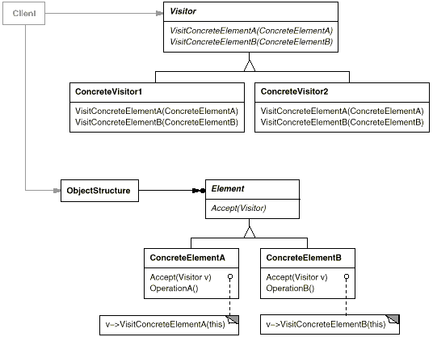
As a Programming Language Feature
Double dispatch, for example: draw(device, figure);

Slide 32
Java Annotation Type for Design Patterns
@interface DesignPattern {
String name();
String[] participants();
}

Slide 33
Annotated File / Directory Example
@DesignPattern {
name = "Composite",
participants = { "Component" }
}
public class Node { ... }
@DesignPattern {
name = "Composite",
participants = { "Composite" }
}
public class Directory extends Node { ... }
@DesignPattern {
name = "Composite",
participants = { "Leaf" }
}
public class File extends Node { ... }

Slide 34
Levels of (Design) Patterns
Architectural Patterns
A.k.a architectual style
Design Patterns
Programming Patterns

Slide 35
Example of an Architectural Pattern
Publish / Subscribe Architecture
  Purpose
    Create a system that can be
      easily extended and
      evolved at runtime
  Components
    Events: Data structures that capture a particular event
    Publishers: Provide (and possibly create) events to the system
    Subscribers: Receive events from publishers
    Event Channels: Link subscribers to publishers
  Examples
    Linda (historic)
    MQSeries (current)
    ESB (whole category)

Slide 36
Example of a Programming Pattern (“Idiom”)
public class Counter {
protected int count = 0;
public synchronized int getNext() {
return count++;
}
...
}

Slide 37
Review / Summary of Session
Design patterns
  Definition, purpose, history
  When compared with other patterns
  Ways of implementing patterns
Collections of patterns
  Collections, handbooks, languages
  Relationships between patterns

Slide 38
Thanks! Questions?
dirk.riehle@fau.de – http://osr.cs.fau.de
dirk@riehle.org – http://dirkriehle.com – @dirkriehle
DR

Slide 39
Credits and License
Original version
  © 2012-2018 Dirk Riehle, some rights reserved
  Licensed under a Creative Commons Attribution 4.0 International License
Contributions
  ...

